Slide 1
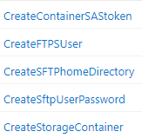
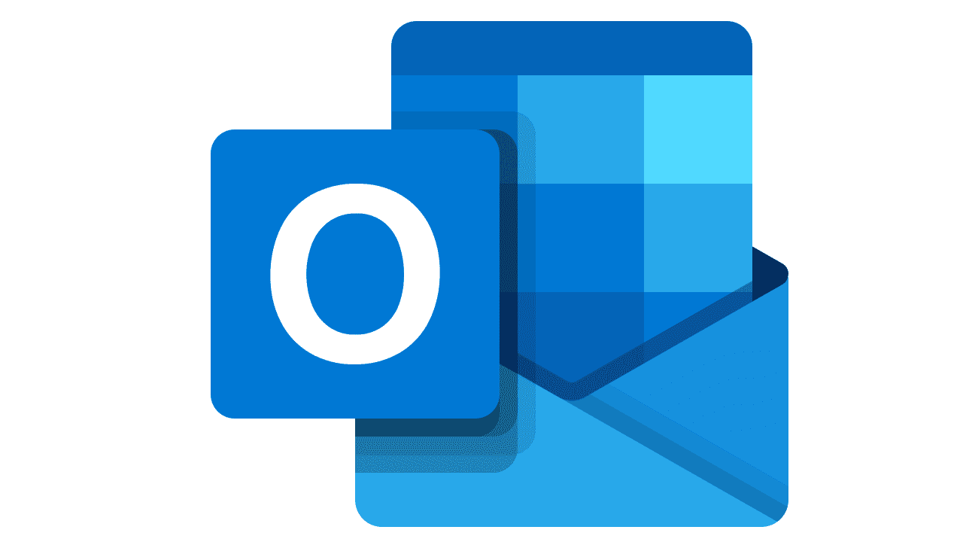







7
6
Send Customer Email with SAS URL or SFTP credentials
Send Approval Request to Mgmt team
5
Power Portal
Generate SAS URL or SFTP credentials
1
External User Registration or Login
2
3
Power Automate
4
Azure Function
User Chooses SFTP for 10’s of Gb or Web Page Upload for < several Gb
Storage accounts
Store customer information
New Record Trigger Flow
Entity Form
SFTP or
Web Page
Dataverse
8
Each customer uploads to customer centric storage container

